Slide 1
2024 Lok Sabha Election Analysis
Ankith b kumar
Kalvium task

Slide 2
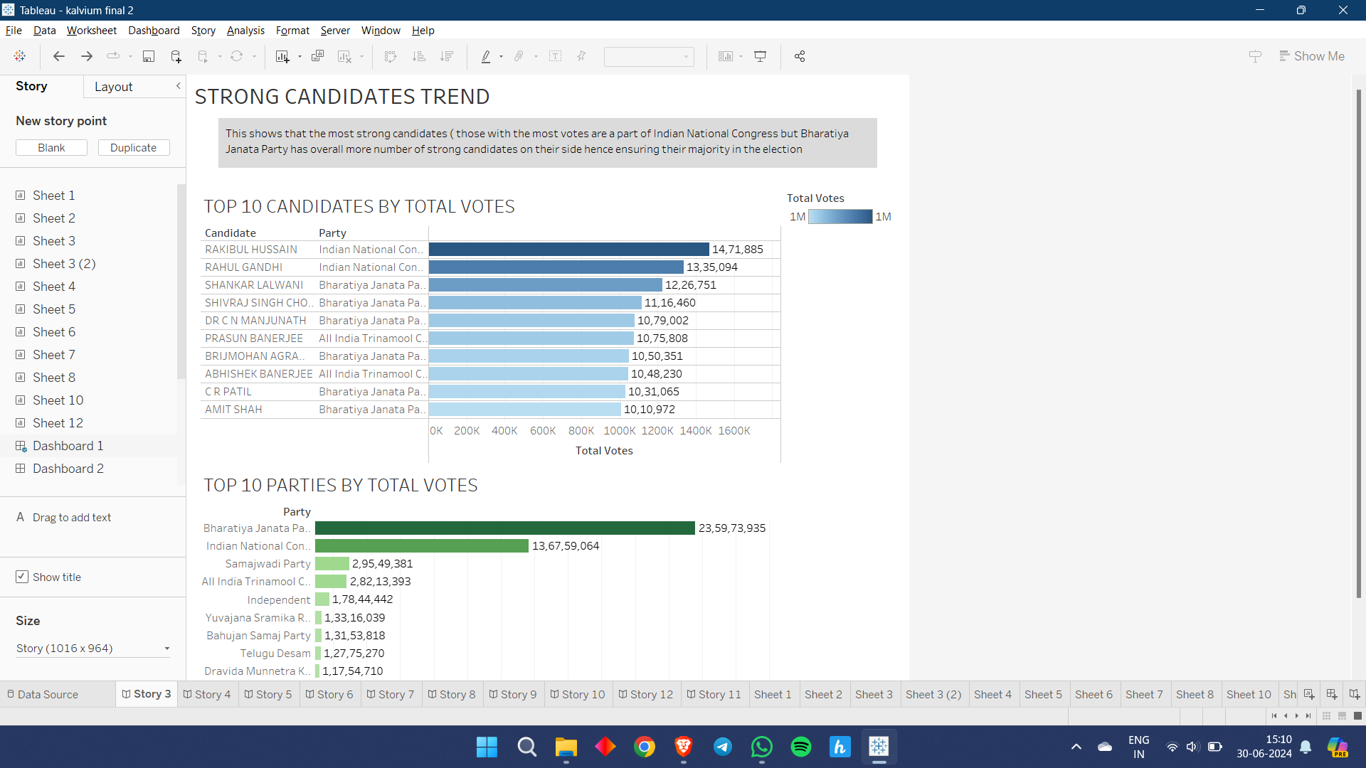
Insight 1 : Candidates Trend
This shows that the most strong candidates ( those with the most votes are a part of Indian National Congress but Bhartiya Janata Party has overall more number of strong candidates on their side hence ensuring their majority in the election

Slide 3
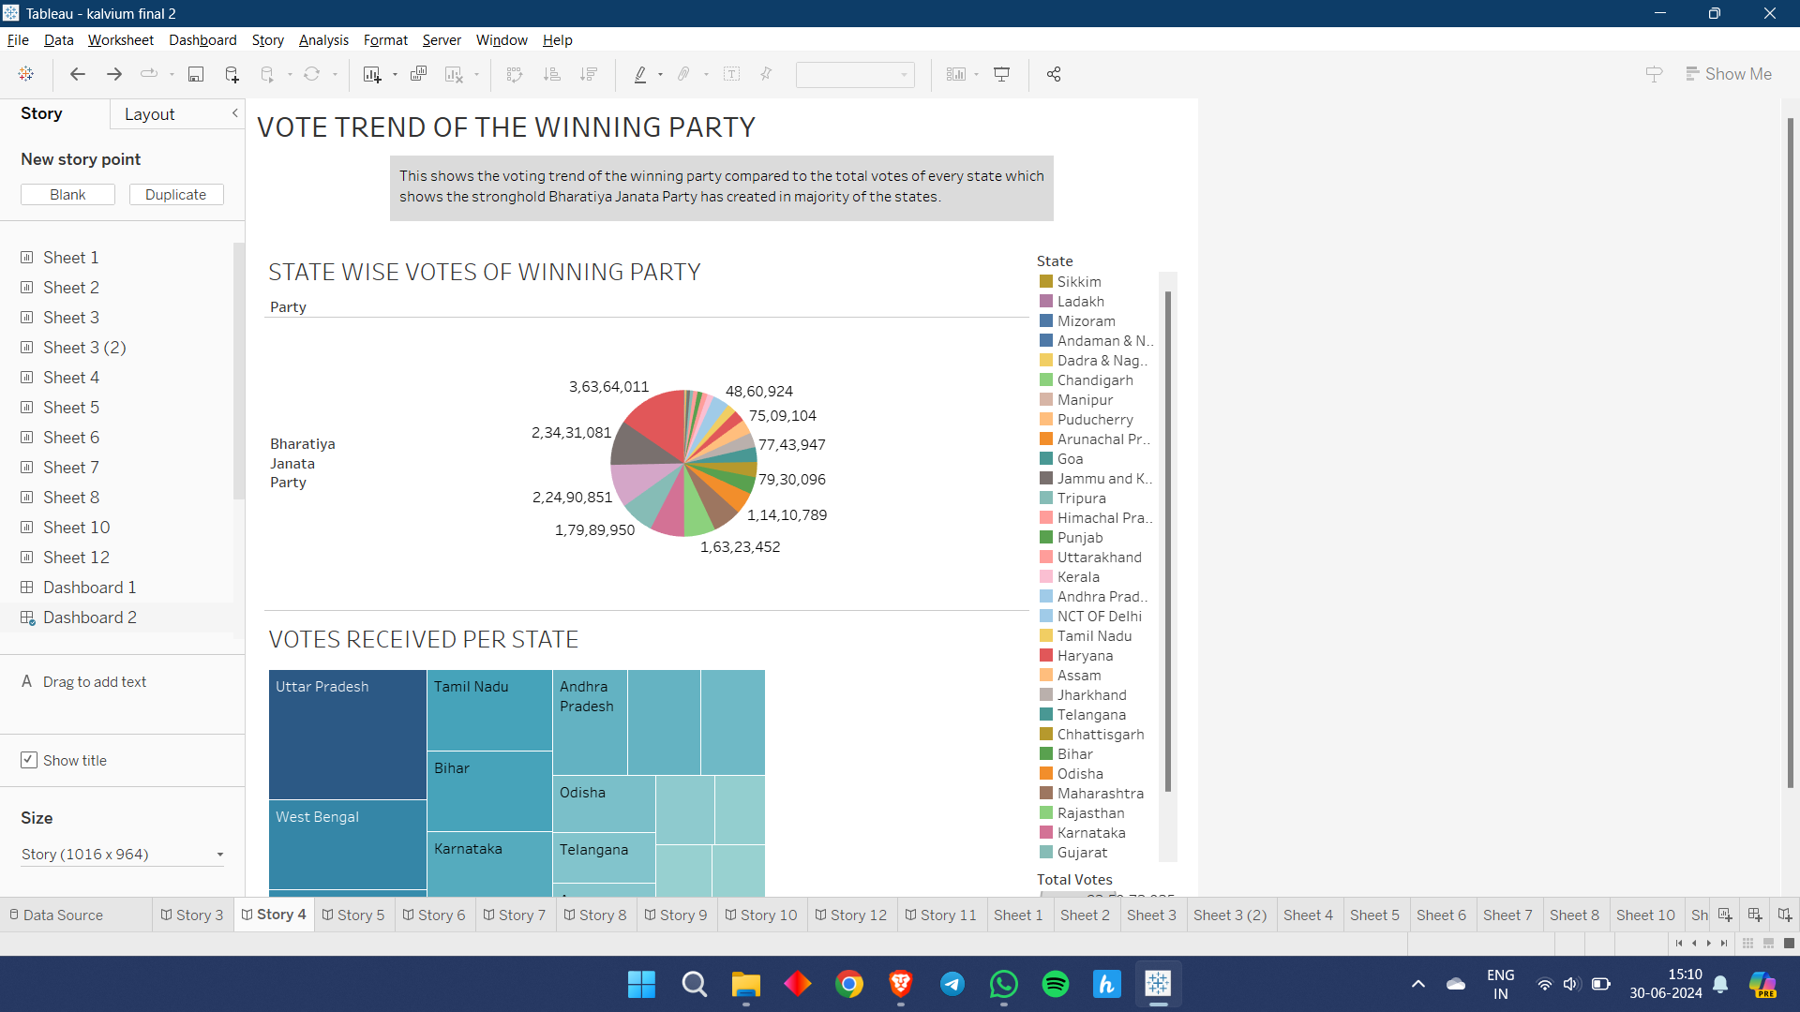
Insight 2 : Winning Party Votes
This shows the voting trend of the winning party compared to the total votes of every state which shows the stronghold Bhartiya Janata Party has created in majority of the states.

Slide 4
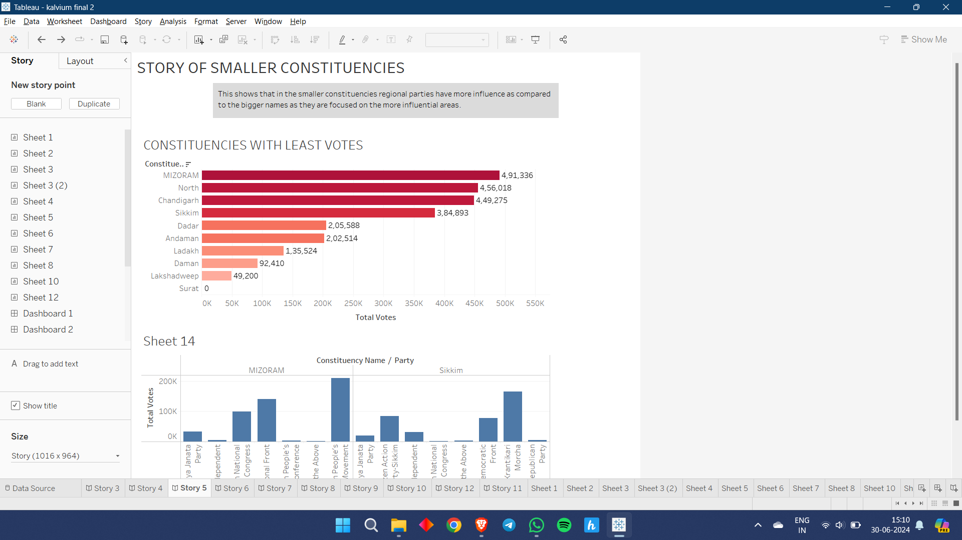
Insight 3 :Story of Smaller Constituencies
This shows that in the smaller constituencies regional parties have more influence as compared to the bigger names as they are focused on the more influential areas.

Slide 5
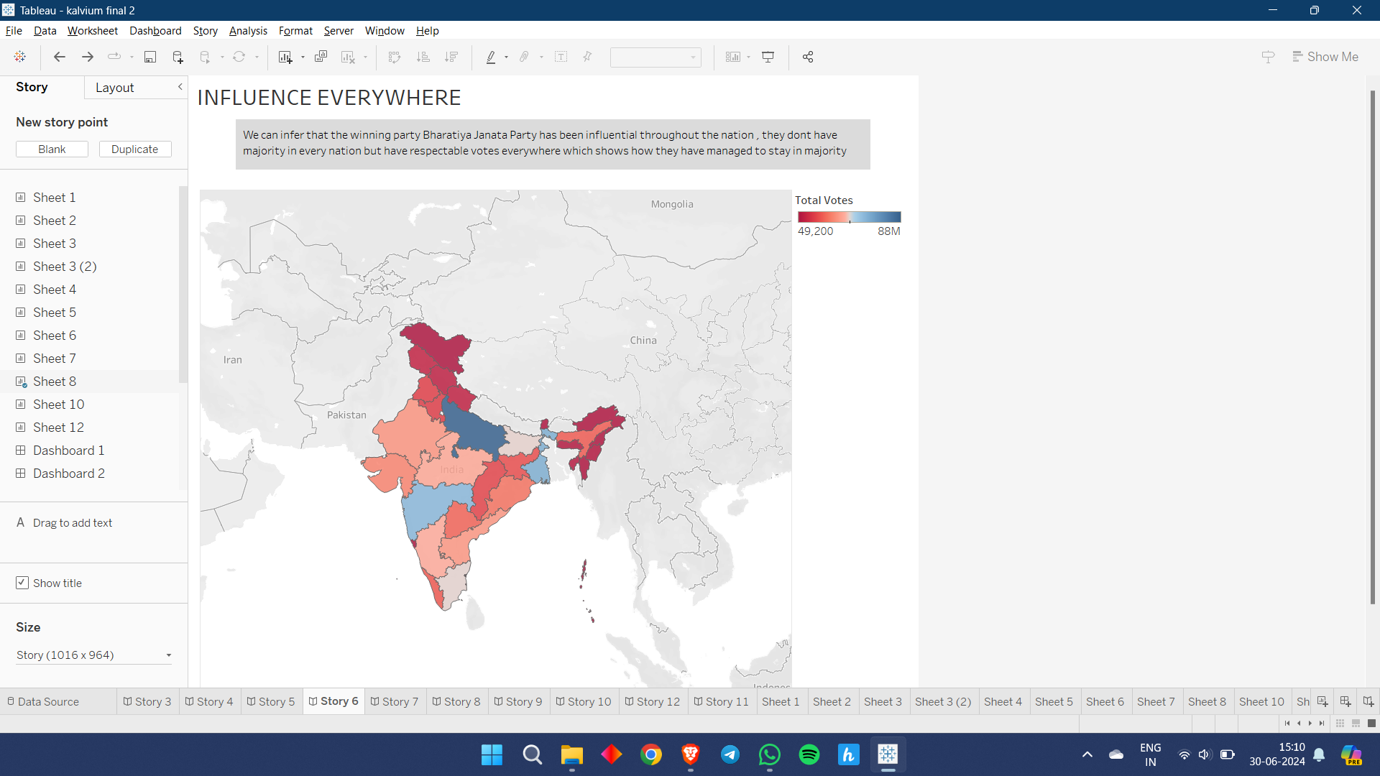
Insight 4 : Influence of BJP
We can infer that the winning party Bharatiya Janata Party has been influential throughout the nation , they dont have majority in every nation but have respectable votes everywhere which shows how they have managed to stay in majority

Slide 6
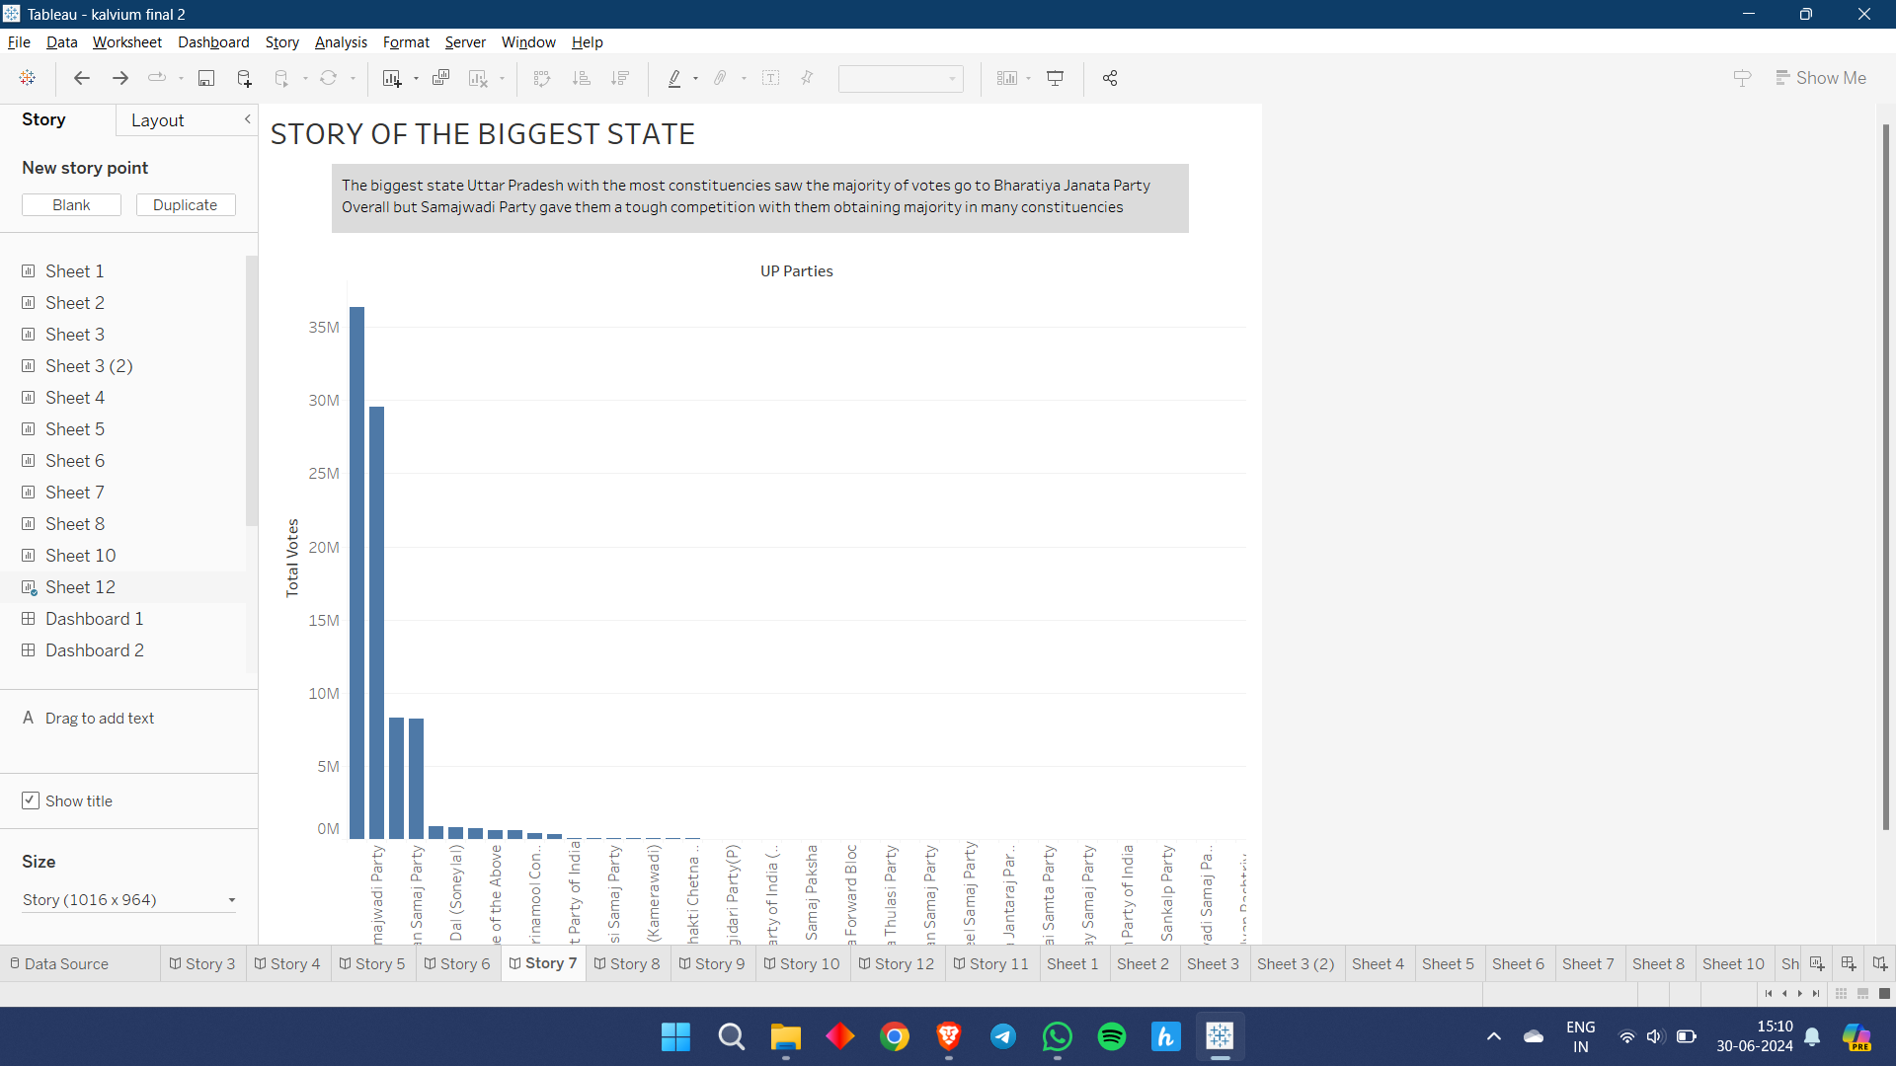
Insight 5 : Voting Trend in the Biggest State
The biggest state Uttar Pradesh with the most constituencies saw the majority of votes go to Bharatiya Janata Party Overall but Samajwadi Party gave them a tough competition with them obtaining majority in many constituencies

Slide 7
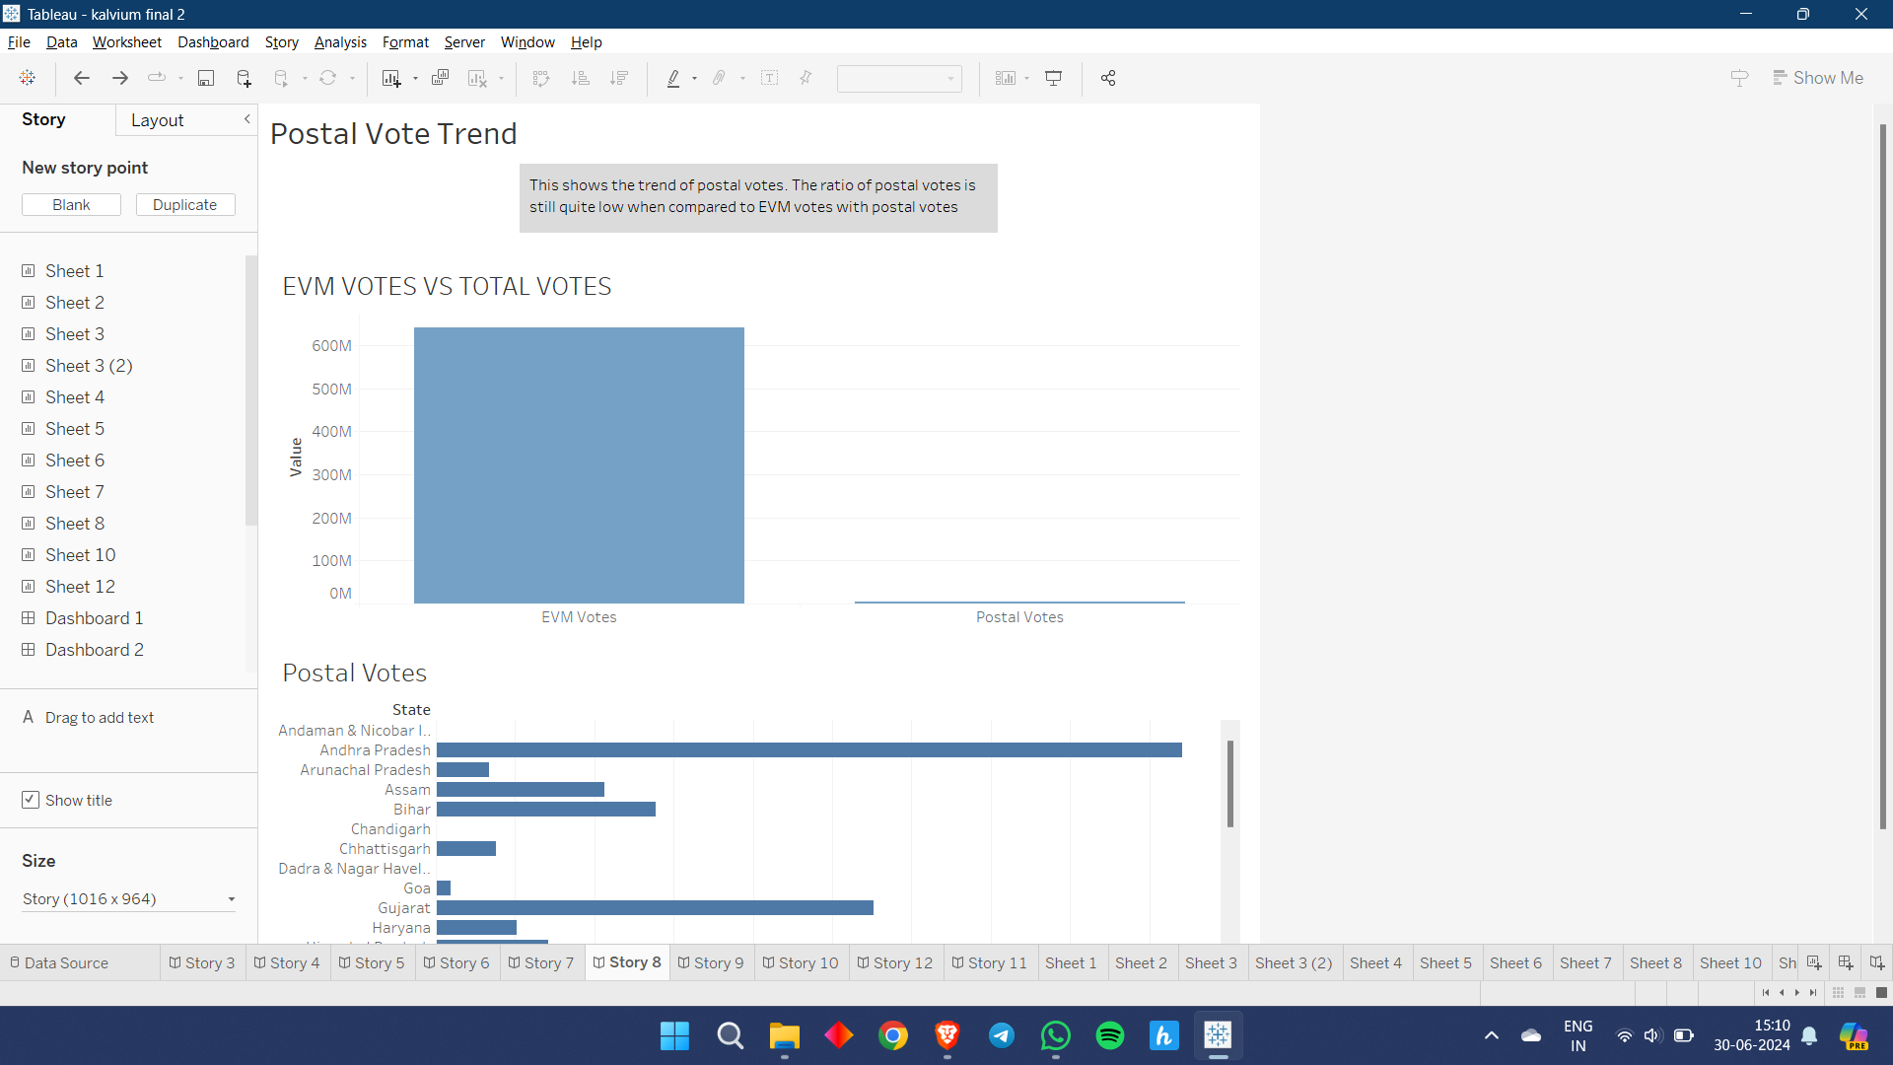
Insight 6 : Postal Vote Trend
This shows the trend of postal votes. The ratio of postal votes is still quite low when compared to EVM votes with postal votes being used for states with remote cities where travelling to booths is hard and with high senior citizen count'

Slide 8
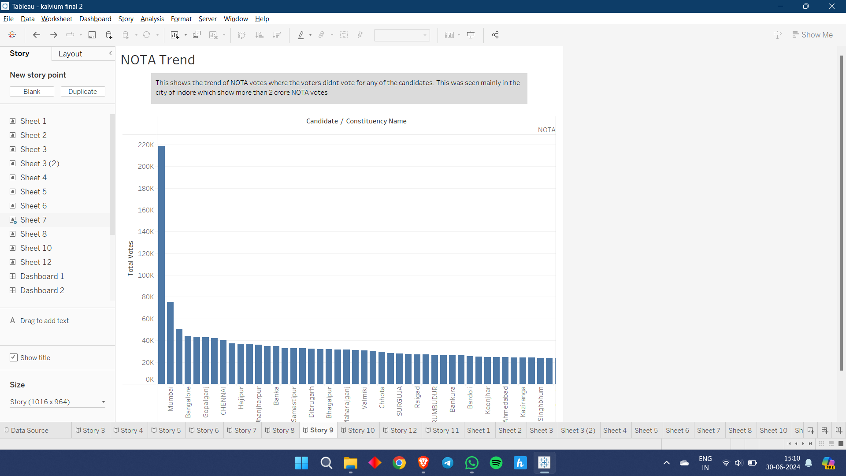
Insight 7 : NOTA Trend
This shows the trend of NOTA votes where the voters didnt vote for any of the candidates. This was seen mainly in the city of indore which show more than 2 crore NOTA votes

Slide 9
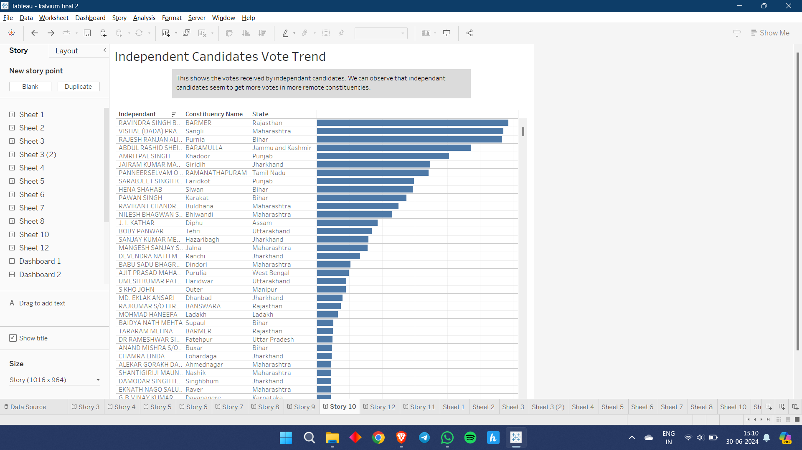
Insight 8 : Independent Candidates Vote Trend
This shows the votes received by independant candidates. We can observe that independant candidates seem to get more votes in more remote constituencies.

Slide 10
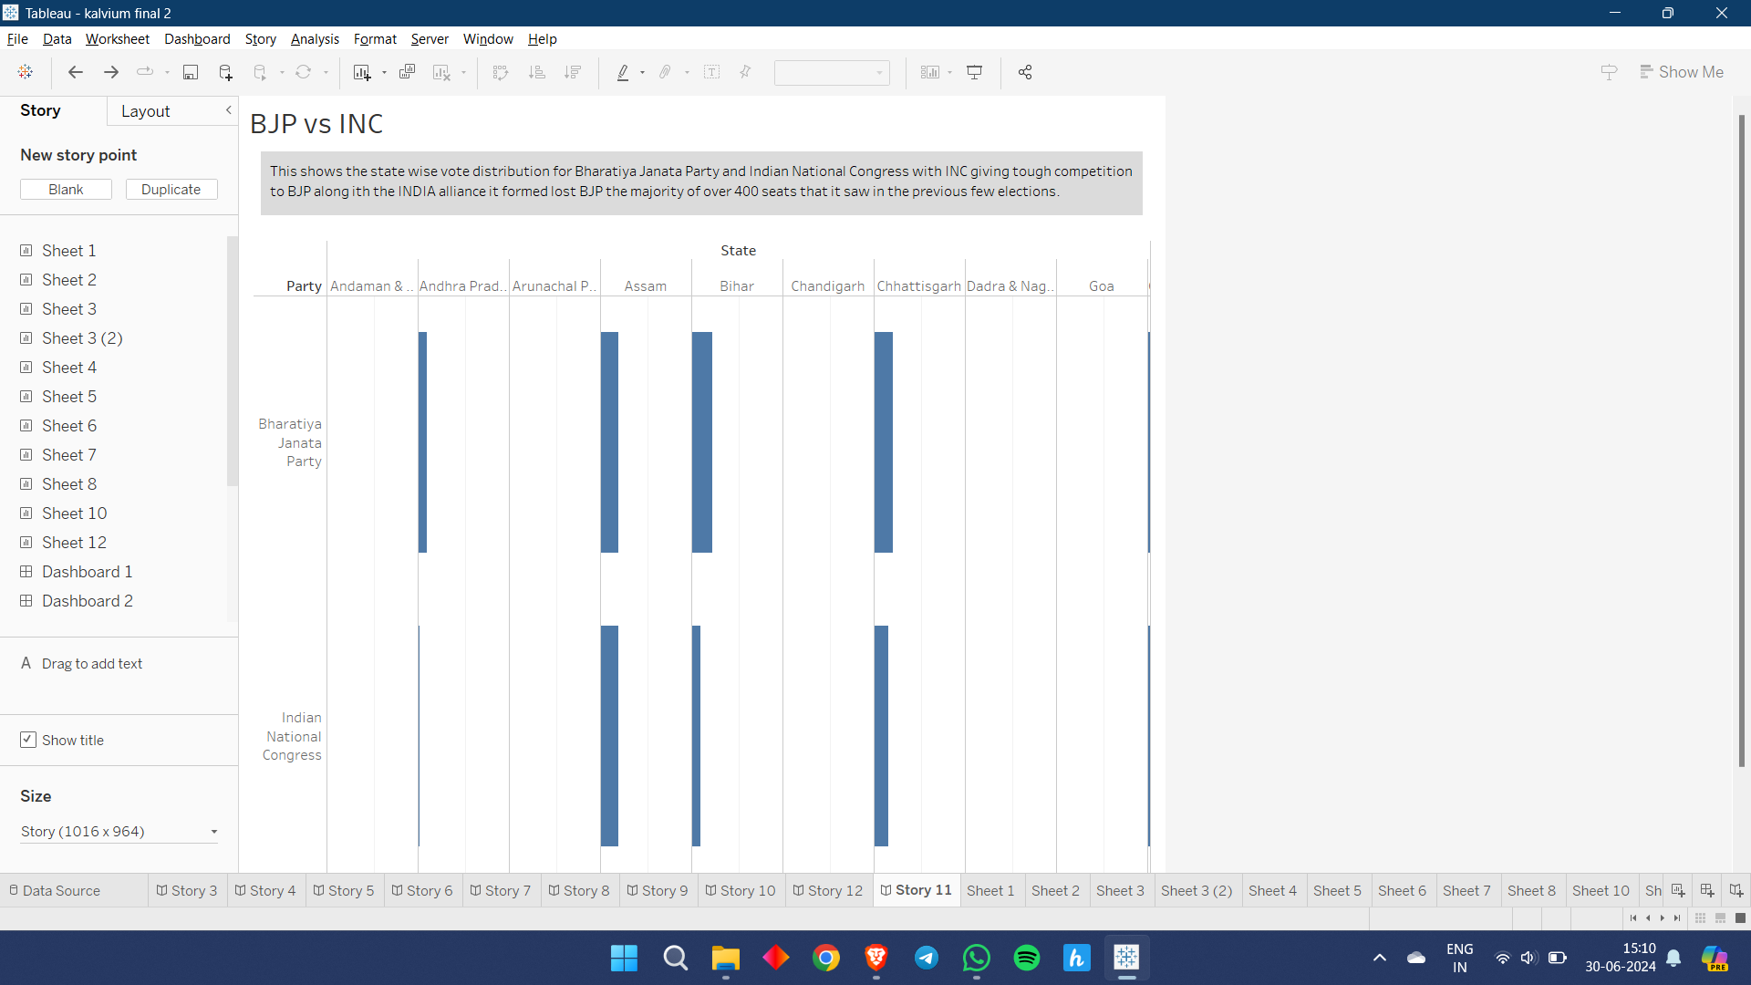
Insight 9 :BJP vs INC
This shows the state wise vote distribution for Bharatiya Janata Party and Indian National Congress with INC giving tough competition to BJP along ith the INDIA alliance it formed lost BJP the majority of over 400 seats that it saw in the previous few elections.

Slide 11
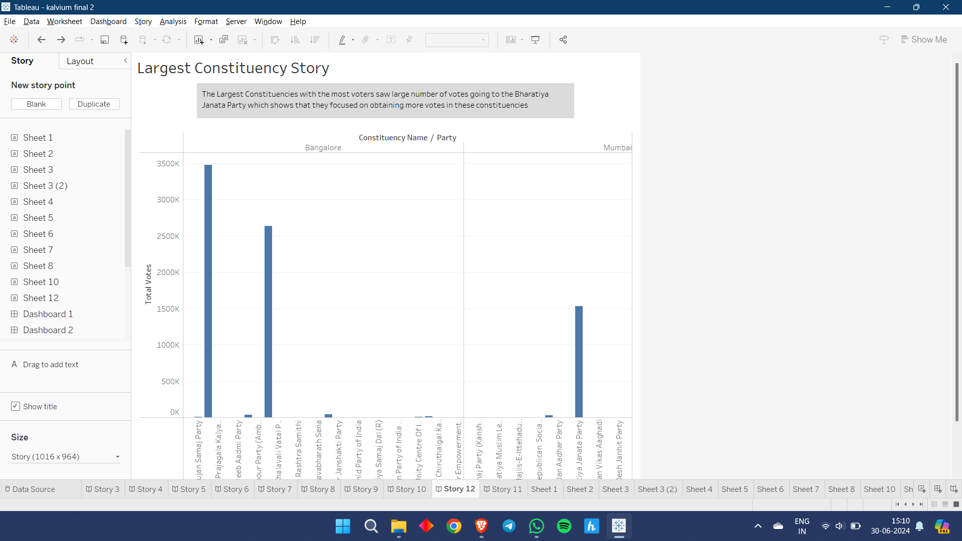
Insight 10 : Story of the Largest Constituency
The Largest Constituencies with the most voters saw large number of votes going to the Bharatiya Janata Party which shows that they focused on obtaining more votes in these constituencies

Slide 12
Thank You

